Slide 1
Mars Robot Challenge
By Oyinade Oyenusi and Julianna Brunn

Slide 2
Robot Configuration...
Ultrasonic Sensor:
This was placed in the front so that our robot could sense when it was close to an object and reverse to find a new path.
Light Sensor:
This was placed in the back facing the ground so that it could distinguish between light and dark in order to trace lines
Standard Sized Gears:
They are better for short stops and turns.
Standard Sized Wheels:
They are easier to turn, and maneuver around on
They can be used in all situations

Slide 3
Forward Program...

Slide 4
Forward Program Continued...
First block:
Moves the gear attached attached to port C
Second block:
Moves gear attached to port B
Third block:
Moves gear attached to port C 360 degrees forward
Fourth block:
Stops the gear attached to port C
Fifth block:
Stops the gear attached to port B
We used this as a general and most common form of transportation

Slide 5
Backward Program...

Slide 6
Backward Program Continued...
First block :
Moves the gear attached attached to port C backward
Second block:
Moves gear attached to port B backward
Third block:
Moves gear attached to port C 360 degrees backwards
Fourth block:
Stops the gear attached to port C
Fifth block:
Stops the gear attached to port C
We used this program as a form of navigation for when the designated checkpoint was passed, for avoiding objectives, and looking for changes in light

Slide 7
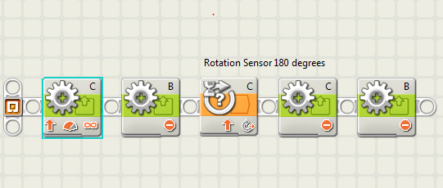
Swing Turn...

Slide 8
Swing Turn Continued...
First block:
Moves gear attached to port C forward
Second block:
Keeps gear attached to port B stationary
Third block:
Moves gear attached to port C 180 degrees forward
Fourth block:
Stops gear attached to port C
Fifth block:
Stops gear attached to port B
We used this program to change the way the robot was facing

Slide 9
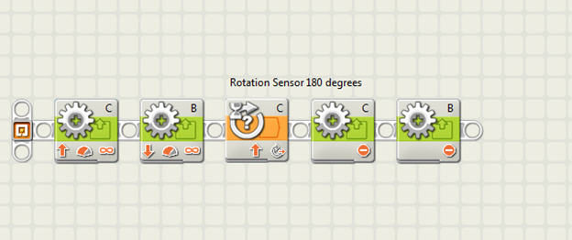
Point Turn...

Slide 10
Point Turn Continued...
First block:
Moves the gear attached to port C forward
Second block:
Moves the gear attached to port B backward
Third block:
Moves the gear attached to port C 180 degrees forward
Fourth block:
Stops the gear attached to port C
Fifth block:
Stops the gear attached to port B
We used this to change the way the robot was facing

Slide 11
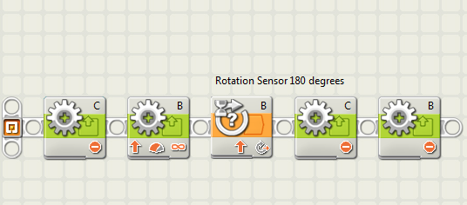
Left Turn...

Slide 12
Left Turn Continued...
First block:
Keeps the gear attached to port C stationary
Second block:
Moves the gear attached to port B forward
Third block:
Moves the gear attached to port B 180 degrees forward
Fourth block:
Stops the gear attached to port C
Fifth block:
Stops the gear attached to port B
We plan to use this to change the way the robot is facing

Slide 13
Inclined and Declined Slopes...
Increased slopes:
Backward program with the power turned up to 100
Decreased slopes:
Forward program with the power turned down to 25
Original power was 75

Slide 14
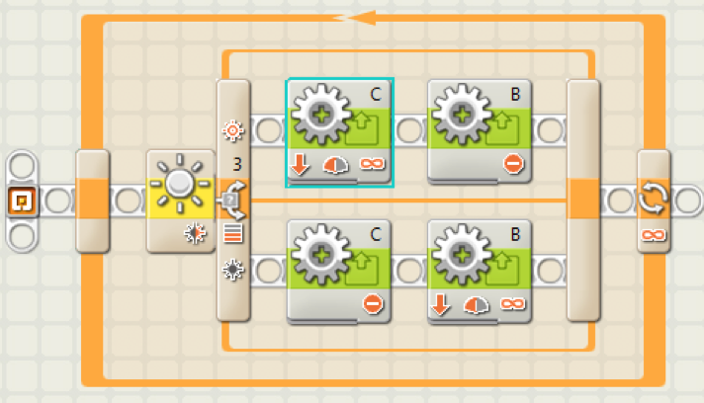
Tracking Curves...

Slide 15
Tracking Curves Continued...
Top left block:
Makes the gear connected to port C move forward
Bottom left block:
Makes the gear connected to port C stop
Top right block:
Makes the gear connected to port B stop
Bottom right block:
Makes the gear connected to port B move forward
Yellow block:
Allows the robot to look for the amount of light that being transmitted below it

Slide 16
Traversing Various Surfaces...
Rocky terrain:
Extended time version of backward program
100 power level
Land where hematite trail is located:
Sonar sensor on the light sensor to track the trail,
75 power level

Slide 17
Traversing Various Surfaces Continued...
Hills:
Increased speed for the incline
Decreased speed for the decline

Slide 18
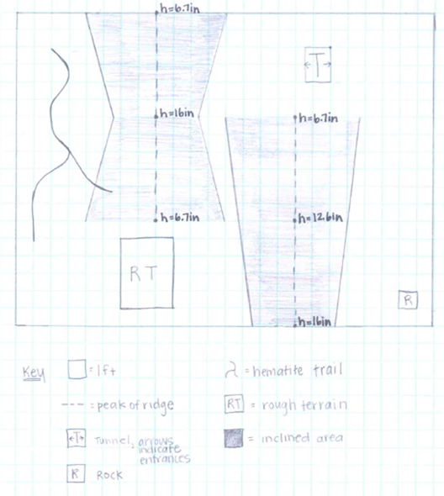
Map of Mars Landing Site...
We hoped to land somewhere that was not on an inclined area in order to avoid having to navigate them...luckily we were successful!
We made sure to have programs to navigate the four obstacles shown:
Hematite trail
Rough terrain
Tunnel
Rock

Slide 19
How Test Simulations Guided the Programming...
We made sure to test our programs multiple times to ensure that it would complete the desired task on Mars
Examples:
We changed our increased slope program from going forwards to moving backwards
We decreased the power level of the hematite trail program from 75 to 50
We changed the number of degrees on our turn programs multiple times after finding out that putting in the said number of degrees didn’t actually make you turn that number of degrees
For completing the rock challenge, we changed our program from using the ultrasonic sensor to moving forward at 1 second increments
As we got closer to the rock, we changed the number of seconds to lower or higher numbers to make sure we did not hit the rock

Slide 20
THANK YOU FOR WATCHING!

